Slide 1
DIGITAL LOGIC DESIGN
EE(109)

Slide 2
Chapter No:2
Number System, Operation and Codes

Slide 3
GRAY CODE:
The bits in a binary count sequence, it is clear that there are often several bits that must change states at the same time. Consider when 3 - bit binary number for 3 change to 4 : all three bits must change state.
011 ( decimal 3 )
100 ( decimal 4 )
In order to reduce the likelihood of a digital circuit misinterpreting a changing input , the Gray code has been developed as way to represent a sequence of numbers.
The unique aspect of the Gray code is that only one bit ever changes between two successive numbers in sequence.
The Gray code is also known as The Reflected Code

Slide 4
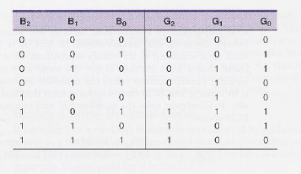
THREE BIT BINARY AND GRAY CODE EQUIVALENTS

Slide 5
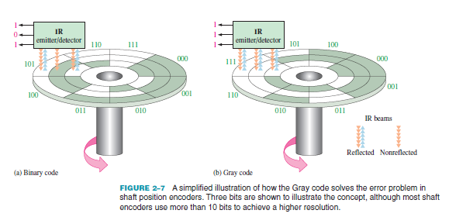
AN APPLICATION
THE CONCEPT OF A 3-BIT SHAFT

Slide 6
BINARY TO GRAY CODE CONVERSION
MSB Binary use as Gray MSB
Compare MSB Binary with next binary bit (B1)
If they are same G1 = 0
If they are different G1 = 1
G0 can be found by comparing B1 and B0

Slide 7
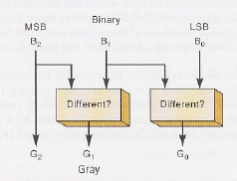
CONVERTING BINARY TO GRAY CODE

Slide 8
GRAY CODE TO BINARY CONVERSION
Gray MSB used as MSB binary
Compare Gray MSB with binary bit (G1)
If they are same B1 = 0
If they are different B1 = 1
B0 can be found by comparing B1 and G0

Slide 9
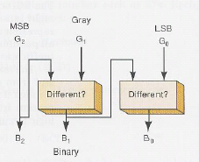
CONVERTING GRAY TO BINARY CODE

Slide 10
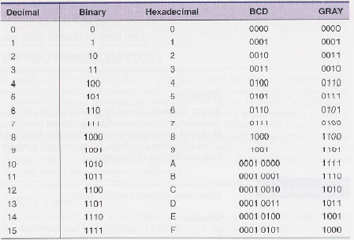
PUTTING ALL TOGETHER

Slide 11
THE BYTE , NIBBLE AND WORD
The Byte :
A string of eight bits is called a Byte .
The Nibble :
A group of four bit( Half of a byte) is called a Nibble.
The Word :
A word is a group of bits that represent s a certain unit of information

Slide 12
ALPHANUMERIC CODES:
The codes that represent letters of the alphabet , punctuation marks, and other special characters as well as numbers are called Alphanumeric Codes.
26 lowercase letter
26 uppercase letter
10 numeric digits
7 punctuation marks
20 to 40 other characters such as + , / , %, * and so on

Slide 13
AMERICAN STANDARD CODE FOR INFORMATION INTERCHANGE( ASCII )CODE:
ASCII is widely used alphanumeric code.
ASCII is a seven –bits code (2⁷ =128 possible code group)
ASCII code for each character can be obtain by converting the hex value to binary.
Character ACSII code Hex Decimal
A 100 0001 41 65
B 100 0010 42 66
0 011 0000 30 48

Slide 14
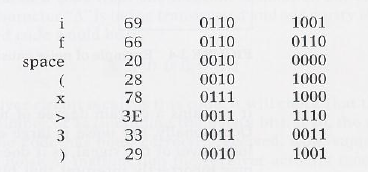

AMERICAN STANDARD CODE FOR INFORMATION INTERCHANGE ( ASCII )CODE:
The ASCII code is used for the transfer of alphanumeric information between a computer and external devices such as printer or another computer.
Example :
The binary string that will be entered into memory when the operator types
if (x >3).

Slide 15
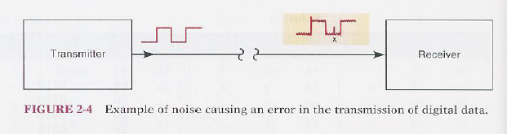
ERROR DETECTION CODES
Examples of the movement of binary data and code :
The transmission of digital voice over a microwave link.
The storage of data in and retrieval of data from external memory devices.
Sending and receiving information on the Internet.
Whenever information transmitted errors can occur such that receiver does not receive the identical information that was sent by transmitter. The major cause of transmission error is electric noise ( fluctuation of current and voltage)
An error detection code can be used to detect error during transmission.
Most modern digital equipment is designed to be relatively error free and the probability of error is very low

Slide 16
PARITY METHOD FOR ERROR DETECTION
One of the simplest and most widely used schemes for error detection is the Parity Method
Parity Bit:
A parity bit is an extra bit that is attached to a code group that is being transferred from one location to another. It is made either 0 or 1.
There are two parity methods:
Even Parity method
Odd Parity method

Slide 17


EVEN PARITY METHOD :
If number of 1s in the code group odd then add a parity bit of 1 .
For example:
If number of 1s in the code group even then add a parity bit of 0 .
For example:

Slide 18
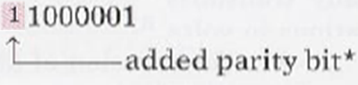
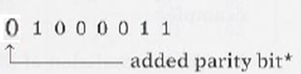
ODD PARITY METHOD :
If number of 1s in the code group even then add a parity bit of 1 .
For example:
If number of 1s in the code group odd then add a parity bit of 0 .
For example:

Slide 19


Suppose that the character A is being transmitted and odd parity is being used .
The transmission code would be
The receiver will check that the code contain an odd number of 1s (including the parity)
If so, receiver assume that the code has been correctly receive.
Supposed Some noise change code as
The receiver will find that this code has an even number of 1s and error is detected.
There is no way that the receiver can tell which bit is in error because it does not know what the code is supposed to be .
The parity method would not work of two bits were in error .

Slide 20
